Slide 2
Learning Objectives (1 of 2)
Summarize new trends in software and service distribution
Describe virtual reality components and applications
Discuss uses of radio frequency identification
Explain quick response codes
Summarize new uses of biometrics

Slide 3
Learning Objectives (2 of 2)
Describe new trends in networking, including grid, utility, and cloud computing
Discuss uses of nanotechnology
Describe blockchain technology and cryptocurrency

Slide 4
Trends in Software and Service Distribution (1 of 7)
Pull technology
User states a need before getting information
Example: entering a URL in a Web browser to go to a certain website
Push technology (i.e., webcasting)
Web server delivers information to users who have signed up for the service
Supported by many Web browsers

Slide 5
Trends in Software and Service Distribution (2 of 7)
Delivers content to users automatically at set intervals or when a new event occurs
Streamlines the process of users getting software updates and updated content
Benefits vendors by keeping in constant touch with users, thus creating customer loyalty
Examples: Microsoft Direct Push (AT&T), Apple Push Notification, and Facebook Push Notification

Slide 6
Trends in Software and Service Distribution (3 of 7)
Application service providers (ASPs)
Provide access to software or services for a fee
Software as a service (SaaS)
ASP delivers software to users for a fee for temporary or long-term use
Offers the recent version of the software
Allows users to save all application data on the ASP’s server

Slide 7
Trends in Software and Service Distribution (4 of 7)
Forms of SaaS model
Software services for general use
Specific service
Service in a vertical market

Slide 8
Trends in Software and Service Distribution (5 of 7)
Advantages of ASPs
Customers do not need to be concerned about whether software is current
Information systems (IS) personnel time is freed up to focus on important applications
Software development costs are spread over several customers
Software is kept up to date, based on users’ requests

Slide 9
Trends in Software and Service Distribution (6 of 7)
ASP contract guarantees a certain level of technical support
Organization’s software costs can be reduced to a predictable monthly fee

Slide 10
Trends in Software and Service Distribution (7 of 7)
Disadvantages of ASPs
Users must accept applications as provided by ASPs; software customization is not offered
Risk of applications not fully meeting the organization’s needs exists
Integration with the customer’s other applications and systems might be challenging

Slide 11
Virtual Reality (1 of 3)
Uses computer-generated, three-dimensional images to create the illusion of interaction in a real-world environment
Simulation: giving objects in a VR environment texture and shading for a 3D appearance
Interaction: enabling users to act on objects in a VR environment
Immersion: giving users the feeling of being part of an environment

Slide 12
Virtual Reality (2 of 3)
Telepresence: giving users the sense that they are in another location and can manipulate objects as though in reality
Full-body immersion: allowing users to move around freely by combining interactive environments with cameras, monitors, and other devices

Slide 13
Virtual Reality (3 of 3)
Networked communication: allowing users in different locations to interact and manipulate the same world at the same time by connecting two or more virtual worlds

Slide 14
Types of Virtual Environments (1 of 2)
Egocentric environment
User is totally immersed in the VR world
Technologies used with the environment
Head-mounted display (HMD)
Virtual retinal display (VRD)

Slide 15
Types of Virtual Environments (2 of 2)
Exocentric environment
User is given a “window view”
Data is rendered in 3D, but users can only view it on screen
Users cannot interact with objects

Slide 16
Components of a Virtual Reality System (1 of 2)
Visual and aural systems
Allow users to see and hear the virtual world
Manual control for navigation
Allows the user to navigate in the VR environment and control various objects

Slide 17
Components of a Virtual Reality System (2 of 2)
Central coordinating processor and software system
Generates and manipulates high-quality graphics in real time and needs a very fast processor
Walker
Captures and records movements of the user’s feet as they walk or turn in different directions

Slide 18
CAVE
Cave automatic virtual environment (CAVE)
Consists of a cube-shaped room in which the walls are rear-projection screens
Holographic device that creates, captures, and displays images in true 3D form
Used for research in archaeology, architecture, engineering, geology, and physics
Used by engineering companies to improve product design and development

Slide 19
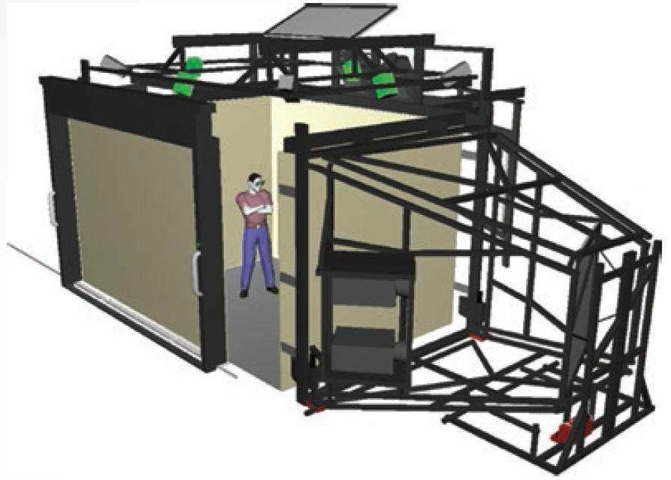
14.3 Example of a CAVE

Slide 20
Virtual Reality Applications
Many applications
Conduct bloodless surgeries
Games and theaters
Business applications
Assistance for the disabled, architectural design, education, and flight simulation
Videoconferencing and group support systems
VR-based therapy

Slide 21
Obstacles in Using VR Systems
Major obstacle
Lack of fiber-optic cables to carry data transmissions needed
Other problems to be solved
Confusion between VR and a real environment
Mobility and other problems with HMDs
Difficulty representing sound
Need for additional computing power

Slide 22
Virtual Worlds (1 of 2)
Simulated environment designed for users to interact via avatars
2D or 3D graphical representation of a person in the virtual world
Used for gaming, in chat rooms, entertainment, and to conduct a variety of business activities

Slide 23
Virtual Worlds (2 of 2)
Widely used virtual worlds
ActiveWorlds
Club Penguin
EGO
Entropia Universe
Habbo
RuneScape
Second Life

Slide 24
Augmented Reality (1 of 2)
Augmented reality (AR): branch of virtual reality that generates a virtual scene that is overlaid on the real object
Goal: enhance the user’s perception of the real-world objects that the user is seeing or interacting with

Slide 25
Augmented Reality (2 of 2)
Difference between augmented reality (AR) and virtual reality
Augmented reality: users stay in the real-world environment while interacting with objects
Aware that they are still in the real world
Virtual reality: users are immersed in the virtual world
Mind is tricked into thinking they are in a new virtual world

Slide 26
Radio Frequency Identification: An Overview (1 of 2)
Radio frequency identification (RFID) tag
Small electronic device consisting of a small chip and an antenna provides a unique identification for the card or the object carrying the tag
Passive type: includes no internal power supply and can be very small
Active: includes an internal power source and is more reliable than a passive tag

Slide 27
Radio Frequency Identification: An Overview (2 of 2)
Privacy and security issues
Ability to read a tag’s contents after an item has left the store
Tags being read without the customer’s knowledge
Tags with unique serial numbers being linked to credit card numbers

Slide 28
14.1 RFID Applications
Category | Examples
Tracking and identification | Railway cars and shipping containers, livestock and pets, supply-chain management, inventory control, retail checkout and POS systems, and recycling and waste disposal
Payment and stored-value systems | Electronic toll systems, contactless credit cards, subway and bus passes, casino tokens, and concert tickets
Access control | Building access cards, ski-lift passes, and car ignition systems
Anticounterfeiting | Casino tokens, high-denomination currency notes, luxury goods, and prescription drugs
Healthcare | Tracking medical tools and patients, process control, and monitoring patient data

Slide 29
Quick Response Codes
Matrix barcode consisting of black modules arranged in a square pattern on a white background
High storage capacity, small printout size, and dirt and dust resistant
Readable from any direction
Compatible with the Japanese character set
Can be read by smartphones equipped with cameras

Slide 30
Biometrics: A Second Look (1 of 3)
Offer a high degree of accuracy that is not possible with other security measures
Used in e-commerce and banking by phone
Example: using voice synthesizers and customers’ voices as the biometric element that identifies them remotely

Slide 31
Biometrics: A Second Look (2 of 3)
Current and future applications
ATM, credit, and debit cards
Network and computer login security
Web page security
Voting
Employee time clocks
Member identification in sport clubs
Airport security and fast check-in

Slide 32
Biometrics: A Second Look (3 of 3)
Passports and highly secured government ID cards
Sporting events
Cell phones and smart cards

Slide 33
Trends in Networking (1 of 15)
Wireless Fidelity (Wi-Fi)
Broadband wireless technology that can transmit information over short distances
Enables one to connect computers, mobile phones and smart phones, MP3 players, PDAs, and game consoles to the Internet
Connections are easy to set up and have fast data transfer rates
Offers mobility and flexibility

Slide 34
Trends in Networking (2 of 15)
Disadvantages of Wireless Fidelity (Wi-Fi)
Susceptible to interference from other devices and to being intercepted
Raises security concerns
Lack of support for high-quality media streaming

Slide 35
Trends in Networking (3 of 15)
Worldwide Interoperability for Microwave Access (WiMAX)
Broadband wireless technology based on the IEEE 802.16 standards
Covers a range of 30 miles for fixed stations and three to ten miles for mobile stations
Fast and easy to install
Enables devices using the same frequency to communicate

Slide 36
Trends in Networking (4 of 15)
Disadvantages WiMAX
Interference from other wireless devices
High costs
Interruptions from weather conditions
Need for a lot of power
Transmission speed decreases when bandwidth is shared among users

Slide 37
Trends in Networking (5 of 15)
Bluetooth
Wireless technology for transferring data over short distances for fixed and mobile devices
Used to create a personal area network (PAN)
Uses a radio technology called Frequency Hopping Spread Spectrum (FHSS)

Slide 38
Trends in Networking (6 of 15)
Used to connect devices such as computers, global positioning systems (GPSs), mobile phones, laptops, printers, and digital cameras
Has no line-of-sight limitations
Susceptible to interception

Slide 39
Trends in Networking (7 of 15)
Grid computing
Involves combining the processing powers of various computers
Allows users to make use of other computers’ resources to solve problems involving large-scale, complex calculations
Each participant in a grid is called a “node”
Processing on overused nodes can be switched to idle servers or desktop systems

Slide 40
Trends in Networking (8 of 15)
Used in bioinformatics, oil and gas drilling, and financial applications
Advantages
Improved reliability
Parallel processing
Scalability
Disadvantages
Some applications are not suitable

Slide 41
Trends in Networking (9 of 15)
Applications requiring extensive memory that a single node cannot provide cannot be used on a grid
Licensing agreements can be challenging
Synchronizing operations in several different network domains can be difficult
Require sophisticated network management
Some organizations are resistant to sharing resources, even if doing so benefits them

Slide 42
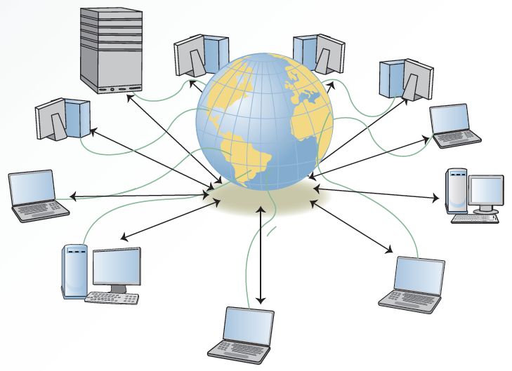
14.8 Grid Computing Configuration

Slide 43
Trends in Networking (10 of 15)
Utility (on-demand) computing
Provision of IT services on demand
Users pay for computing or storage resources on an as-needed basis
Advantage: convenience and cost savings
Drawbacks: privacy and security
Can work with the SaaS model
Enables one to request computing power and memory from the provider

Slide 44
Trends in Networking (11 of 15)
Cloud computing
Incorporates many recent technologies under one platform
Includes SaaS model, Web 2.0, grid computing, and utility computing
Includes components in the form of:
Infrastructure as a service (IaaS)
Platform as a service (PaaS)
Software as a service (SaaS)

Slide 45
Trends in Networking (12 of 15)
Cloud computing includes many of the advantages and disadvantages of distributed computing
Users can request services, applications, and storage
Services typically require a fee; some are free

Slide 46
Trends in Networking (13 of 15)
Public, private, hybrid, and community clouds: which one to choose
Organizations choose clouds based on security needs and level of involvement required
Public cloud: users connect with an off-site infrastructure over the Internet, which is shared by a large number of users
Private cloud: services and the infrastructure are run on a private network

Slide 47
Trends in Networking (14 of 15)
Hybrid cloud: chosen by organizations that operate on both private and public data; collection of at least one private and at least one public cloud
Community cloud: infrastructure is designed for exclusive use by a specific community of users from organizations that share common concerns

Slide 48
Trends in Networking (15 of 15)
Cloud computing versus edge computing
Edge computing pushes processing and data to the near edge of the network that enables timely collection, processing, and analysis
Provides on-device processing and analytics in real time
Cloud computing processes data in centralized cloud and data centers
May not be as fast and efficient

Slide 49
Cloud Computing Security (1 of 2)
Organization that uses cloud computing should:
Provide end-user education
Force software updates
Work with the cloud computing provider to spot unusual activities

Slide 50
Cloud Computing Security (2 of 2)
Cloud-computing security risks
Privileged user access
Regulatory compliance
Data location
Data segregation
Recovery
Investigative support
Long-term viability

Slide 51
Nanotechnology
Incorporates techniques involving structure and composition of materials on a nanoscale
Plays a role in several areas
Energy
Information and communication
Heavy industry
Consumer goods incorporating nanotechnology (nanomaterials) are available in the market

Slide 52
Blockchain Technology and Cryptocurrency (1 of 6)
Blockchain: decentralized and distributed network
Used to record transactions across connected devices as blocks of data that cannot be altered after being recorded

Slide 53
Blockchain Technology and Cryptocurrency (2 of 6)
Blockchain applications
Tracking food and other goods
Secure software development
Digital content management
Improving healthcare records integrity
Mortgage approval process
Improving and speeding up insurance claims processing

Slide 54
Blockchain Technology and Cryptocurrency (3 of 6)
Blockchain applications (continued)
Audit trail
Electronic voting
Smart contracts

Slide 55
Blockchain Technology and Cryptocurrency (4 of 6)
Cryptocurrency: digital money created from computer codes
Monitored by a peer-to-peer Internet protocol
No third party bank or financial institution
Popular types
Bitcoin (BTC), Ripple (XRP), Ethereum (ETH), Monero (XMR), LiteCoin (LTC), and Zcash (ZEC)

Slide 56
Blockchain Technology and Cryptocurrency (5 of 6)
Cryptocurrency advantages
Cannot be counterfeited or reversed by the sender
Immediate settlement
Lower transaction fees
No risk for credit theft

Slide 57
Blockchain Technology and Cryptocurrency (6 of 6)
Cryptocurrency disadvantages
Not widely accepted
No way to reverse the payment
Uncertainty with respect to the regulations
Potential for financial loss because of data loss
Potential for high price volatility and manipulation
Often not exchangeable for fiat currency

Slide 58
Summary (1 of 3)
Recent trends in software and service distribution include pull technology, push technology, and ASPs
VR technology has added the third dimension, so users can interact with objects in a way not possible before
RFID devices are more popular with the retail industry and other industries

Slide 59
Summary (2 of 3)
QR codes have grown in popularity as a marketing tool
Recent trends in networking technologies include wireless technologies, grid computing, WiMAX, and cloud computing
Nanotechnology is currently too expensive to justify its use in many applications

Slide 60
Summary (3 of 3)
A blockchain is a decentralized and distributed network
Used to record transactions across connected devices as blocks of data that cannot be altered after being recorded
Cryptocurrency is probably the most popular application of blockchain technology

